Slide 1

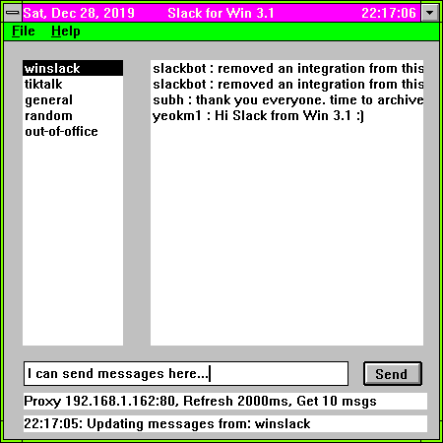
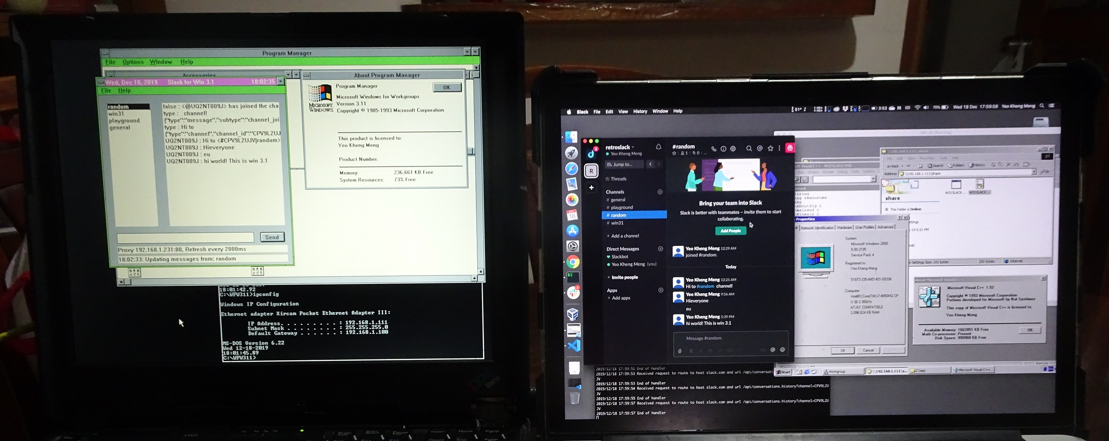
Lessons from coding a new-old app: Slack for Windows 3.1
By: Yeo Kheng Meng (@yeokm1)
http://yeokhengmeng.com/2019/12/building-a-new-win-3-1-app-in-2019-part-1-slack-client/
https://github.com/yeokm1/w31slack
https://github.com/yeokm1/http-to-https-proxy
JuniorDevSG (14 Jan 2020)
SP Digital Tik Talk (9 Jan 2020)

Slide 2

Join the retroslack workspace
https://bit.ly/2FL5IRS

Slide 3



@subhransu

Slide 4
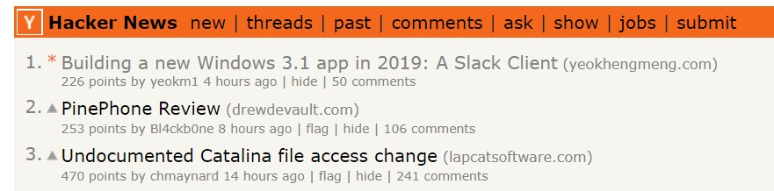
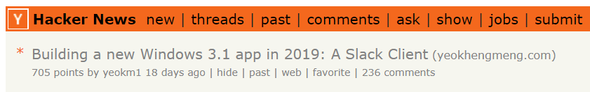
#1 on Hacker News!
https://news.ycombinator.com/item?id=21831951

Slide 5
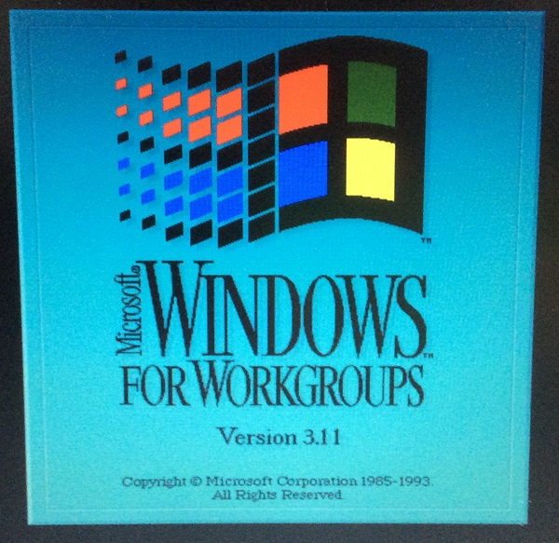
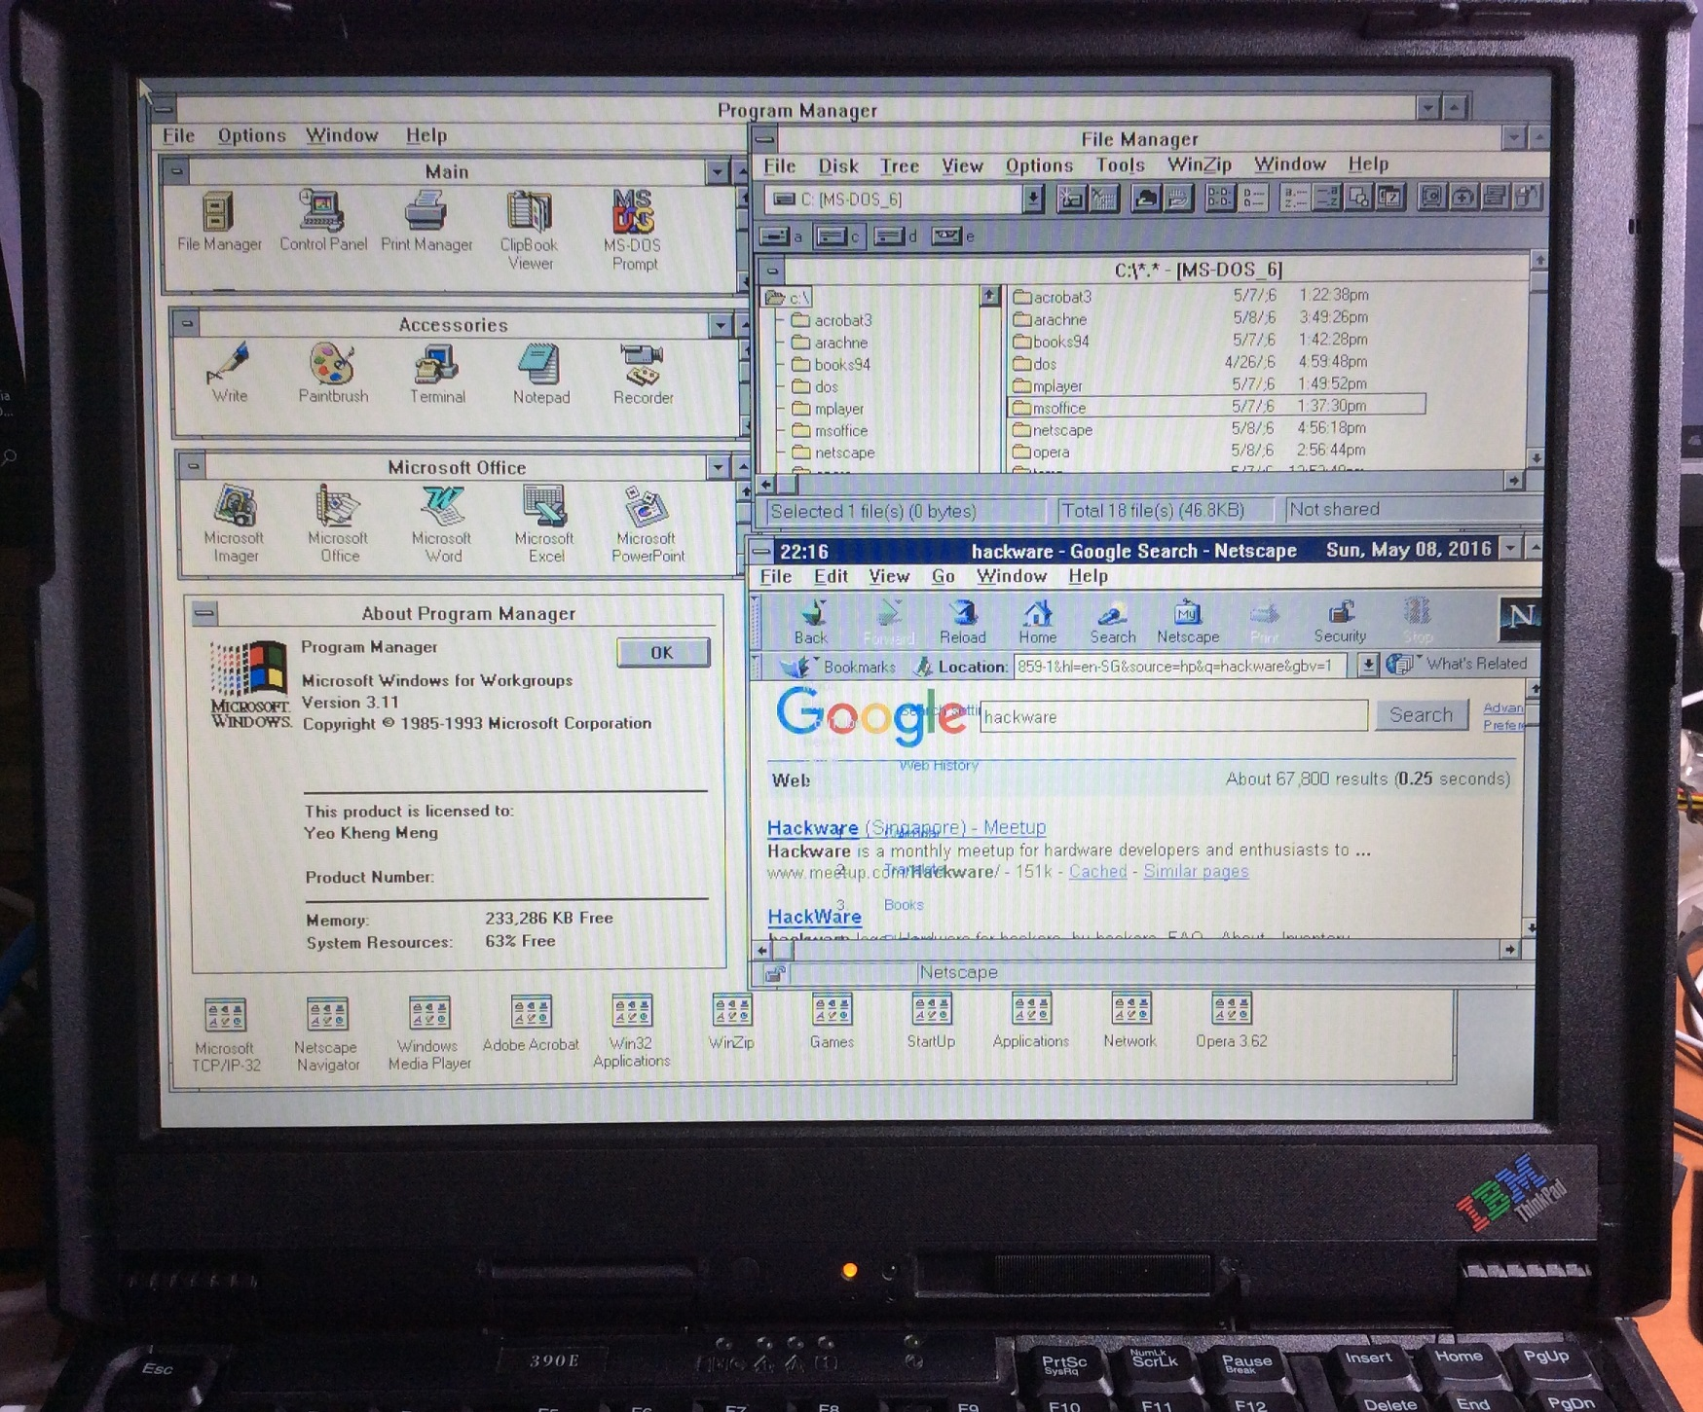
So what is Windows 3.1x?
Windows 3.1x is a series of 16-bit operating systems by Microsoft
Windows 3.1 was released on April 6, 1992
Windows for Workgroups 3.11 was released on August 11, 1993
WFW first to have inbuilt networking facilities

Slide 6
Go to #win31 channel

Slide 7




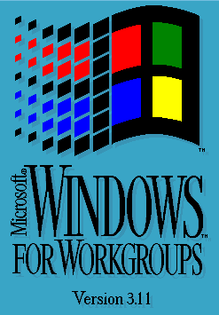


Development Setup
Mac OS Catalina
Bridged Network
SMB share folder
SMB share folder
IBM Thinkpad 390E (1999)
Pentium II (300Mhz)
384 MB RAM

Slide 8
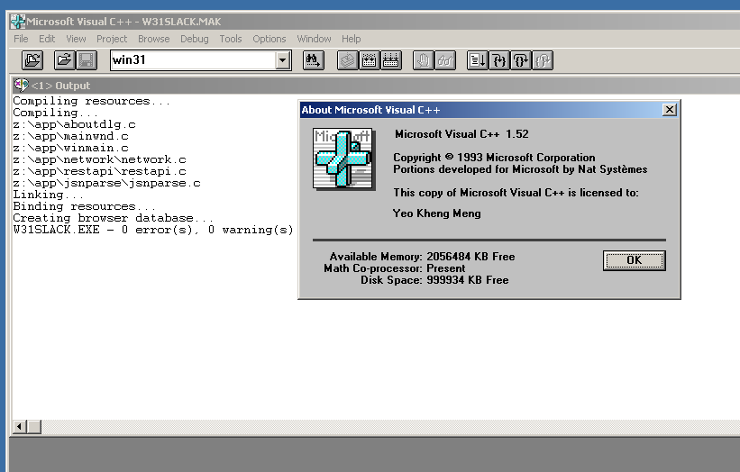
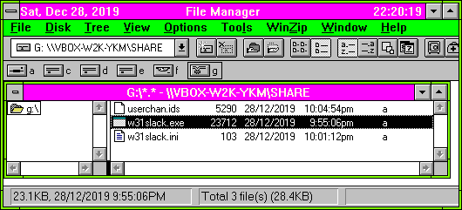
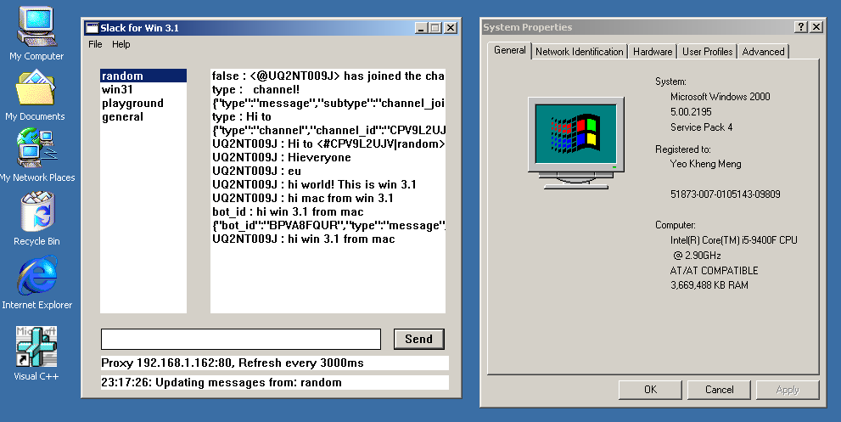
Visual C++ 1.52 on Win 2000 in Virtual Box
VC++ 1.52 last MS Win 3.1 compiler
Released in 1993
16-bit compiler
Officially runs on up to 32-bit Windows
Win 2000 VM
Lightest fully-supported Virtualbox OS
SMB support with Win 10/ Mac and Win 3.1

Slide 9
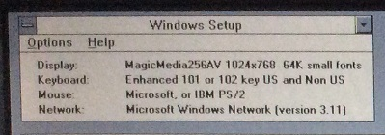
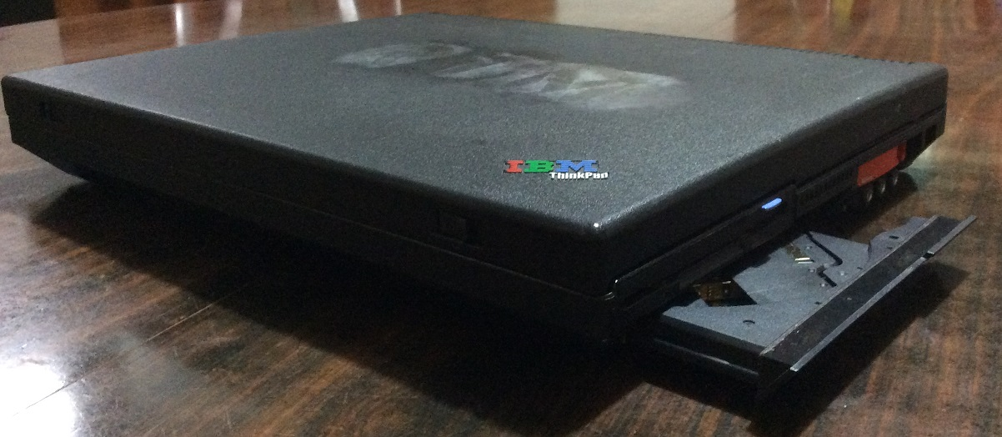
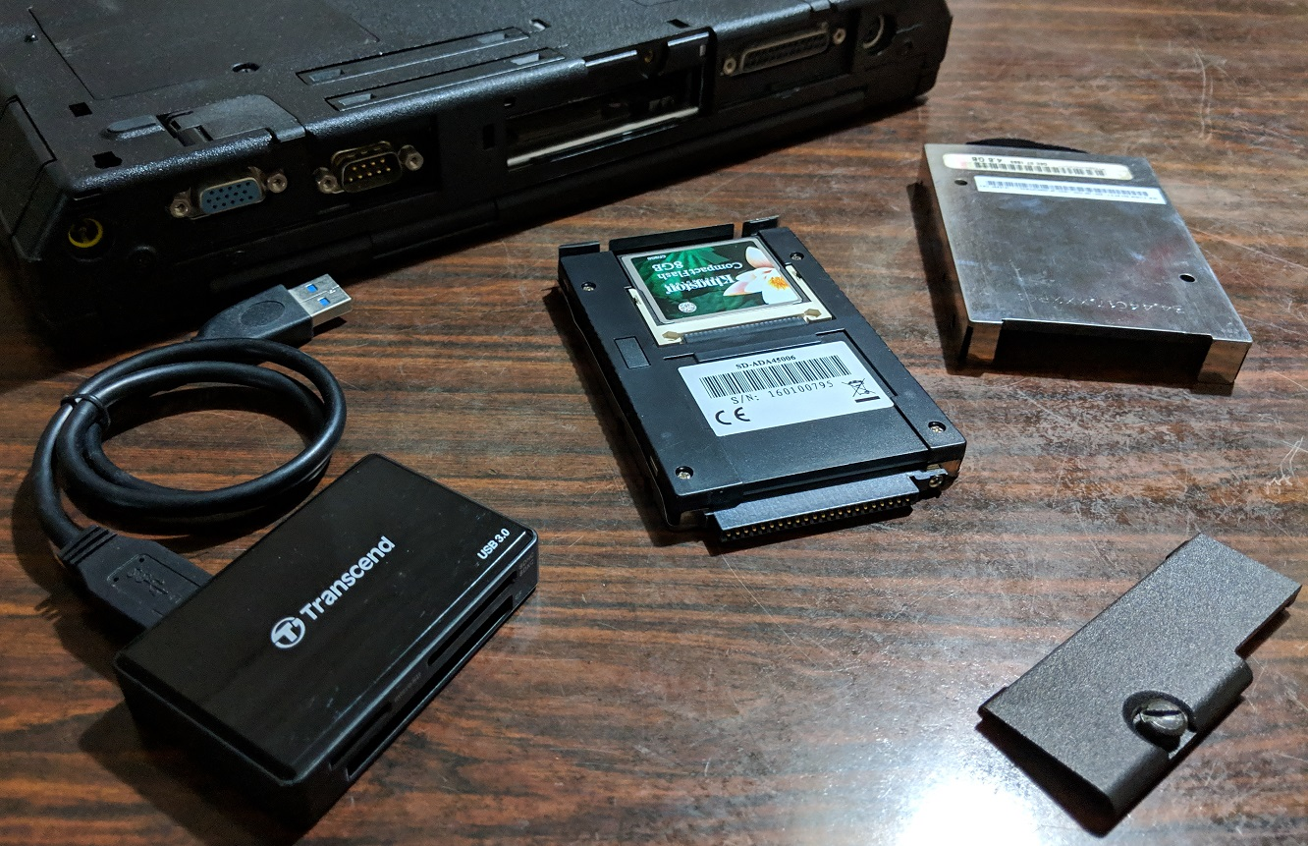
Test Setup: IBM Thinkpad 390e
Released in 1999 with Windows 98
Win3.1 drivers provided by IBM
Specifications
Intel Mobile Pentium II 300Mhz
NeoMagic Media256AV 2.5MB VRAM
384MB SDRAM (256MB usable by Win 3.1)
13.1” 1024×768
CF card with CF-PATA converter
CDROM + Floppy combo
No Ethernet
4.5cm thickness
3.4kg weight
US$2700 (1999) = US$4168 (2019) = SG$5630 (2019)
9

Slide 10
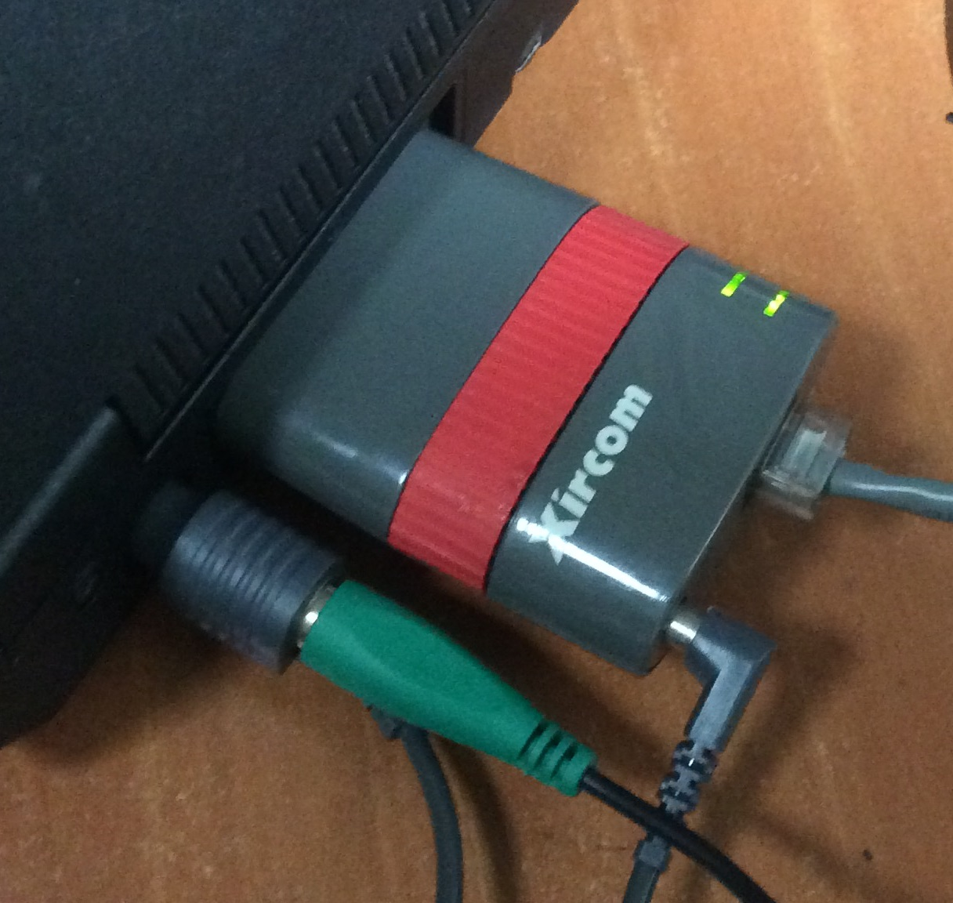
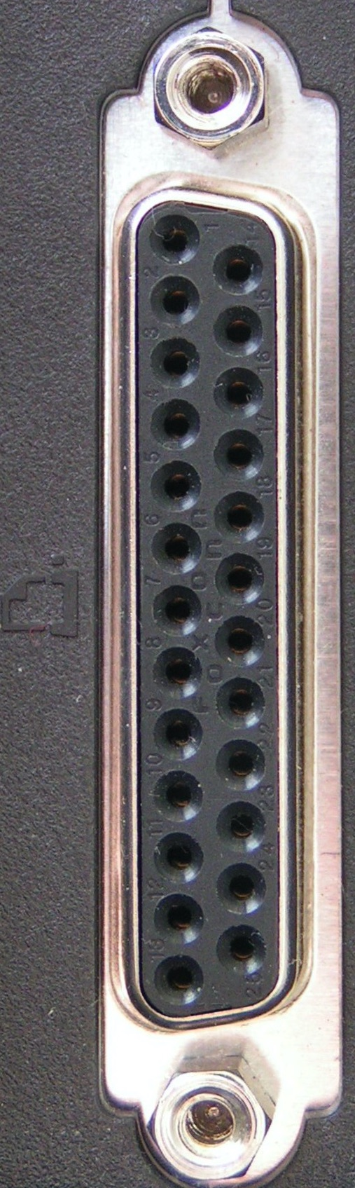
Connecting the ancient Thinkpad to the internet
Parallel Port network adapter
Xircom Pocket Ethernet PE3-10BT
10Mbps
Powered by PS/2 passthrough cable

Slide 11
Now let’s get down to coding stuff

Slide 12


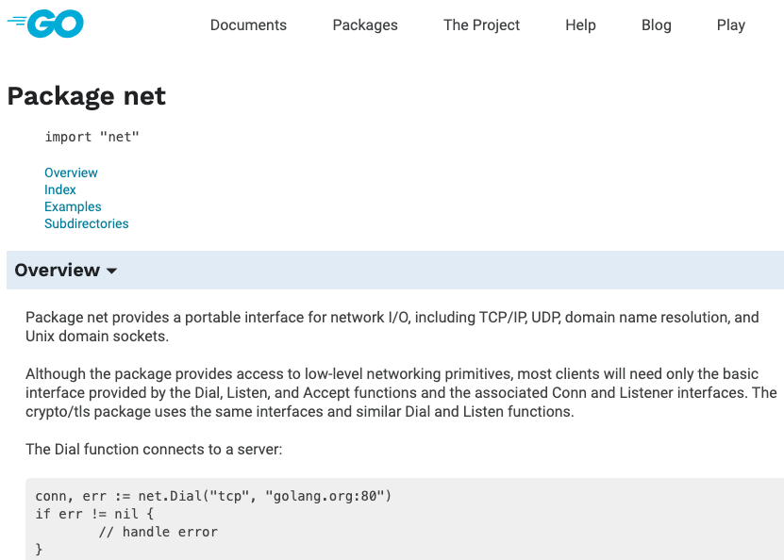
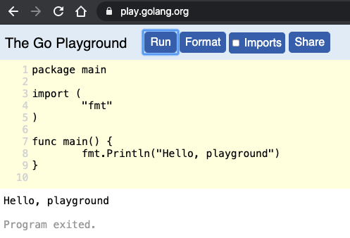
Coding resources today
X
X
Language/API documents
Online Code Simulators

Slide 13
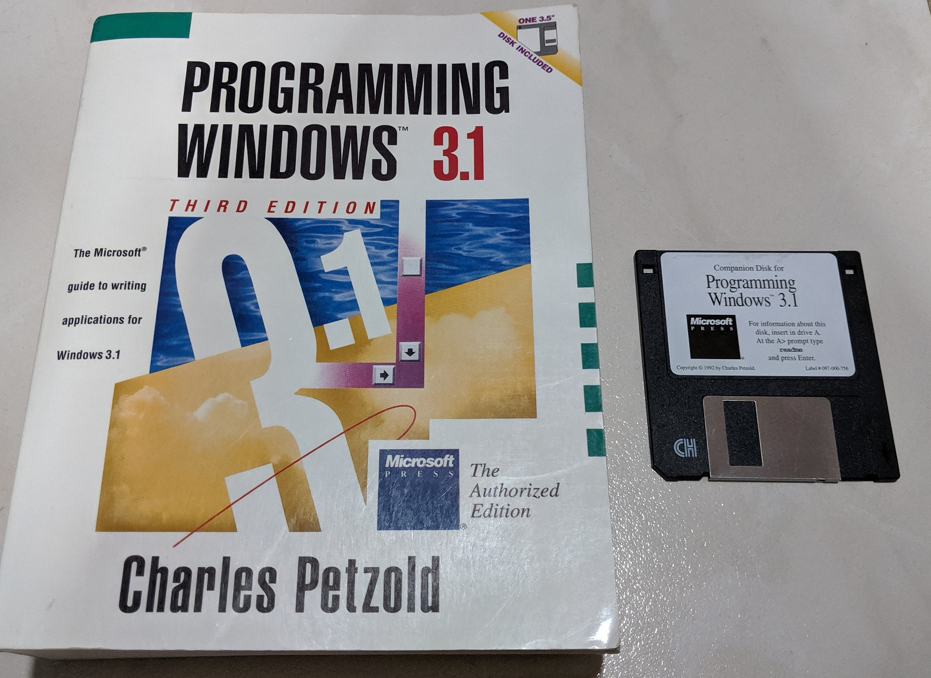
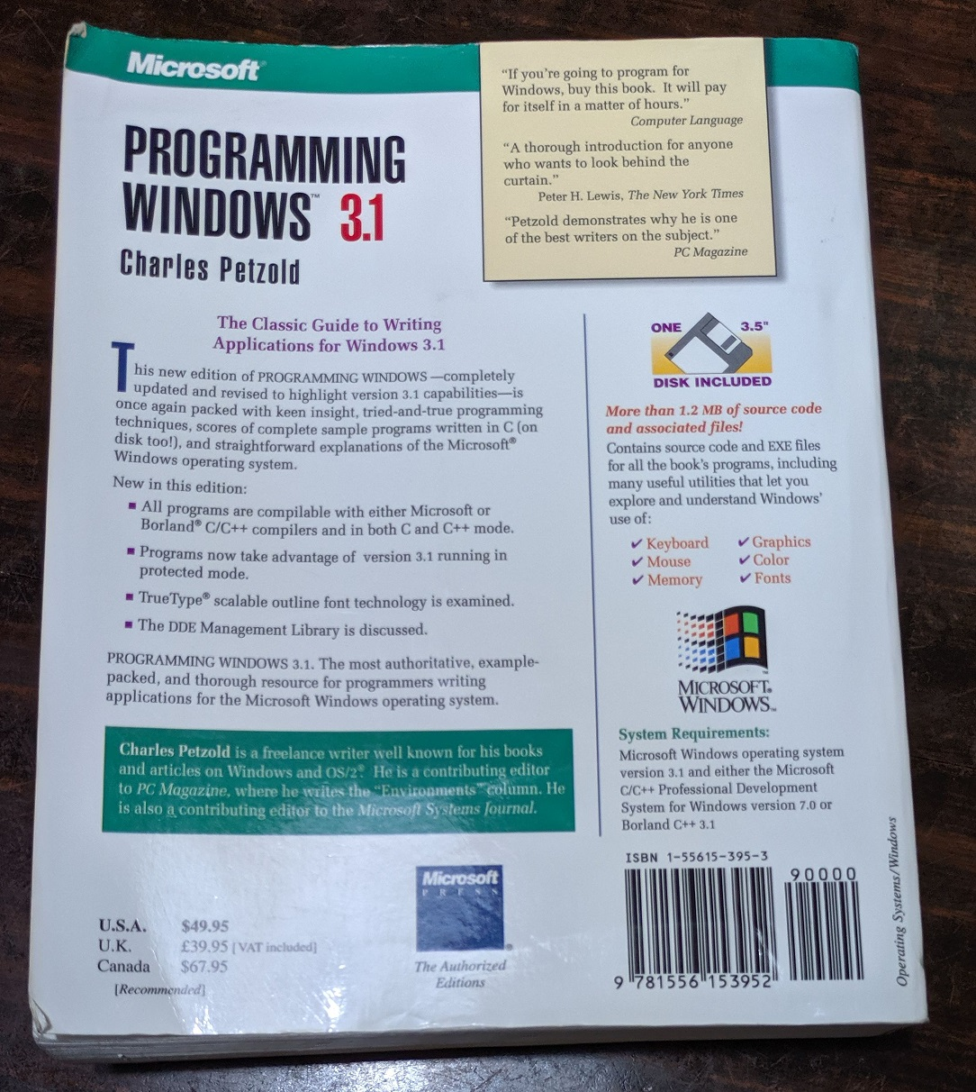
Old-fashioned documentation: Books
Programming Windows 3.1 by Charles Petzold (published Sept 1992)
“If you are going to program for Windows (3.1), buy this book. It will pay for itself in a matter of hours.”

Slide 14
C language
VC++ 1.52 supports only C89
Ratified in 1989 as ANSI X3.159-1989 "Programming Language C”
Nowadays C99, C11, C18

Slide 15
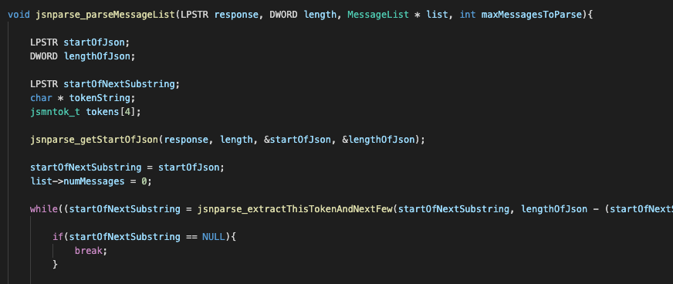
C89: Variable declaration at scope beginning
Cannot declare new variables in middle of scope
All variables you need in a function must be place at the top
-> May increases code readability. You know what variables are used by scanning the top.

Slide 16
C89: Unsafe functions (Eg. sprintf vs snprintf)
int sprintf ( char * str, const char * format, ... );
Write printf formatted data to string
sprintf (buffer, ”Data is %s”, data);
int snprintf ( char * s, size_t n, const char * format, ... );
Printf formatted output of n-length to buffer
snprintf (buffer, n, ”Data is %s”, data);
Released in C99
snprintf prevents buffer overflow

Slide 17
16-bit Computing
“In the context of IBM PC compatible and Wintel platforms, a 16-bit application is any software written for MS-DOS, OS/2 1.x or early versions of Microsoft Windows which originally ran on the 16-bit Intel 8088 and Intel 80286 microprocessors.
…
Programs containing more than 2^16 bytes (65,536 bytes) of instructions and data therefore required special instructions to switch between their 64-kilobyte segments, increasing the complexity of programming 16-bit applications.”
https://en.wikipedia.org/wiki/16-bit#16-bit_application

Slide 18
Stack and heap app memory limits
 | Modern Mac/Linux
Stack | 8 MiB
Heap | 32-bit: 4GiB 64-bit: Terabytes…
Pointer size | 32-bit: 80386 CPUs and up 64-bit: AMD64 and up

Slide 19
Stack and heap app memory limits
 | Modern Mac/Linux | 16-bit Win3.1
Stack | 8 MiB | ~4 KiB
Heap | 32-bit: 4GiB 64-bit: Terabytes… | Local Heap: Up to 64KiB Global Heap: 64 KiB segments up to 16 MiB
Pointer size | 32-bit: 80386 CPUs and up 64-bit: AMD64 and up | NEAR: 16-bit FAR: 16-bit selector : 16-bit offset
Allocate NEAR pointer: void* malloc( size_t size ) or LocalAlloc
Win 3.1’s FAR pointer is based on 286 Protected Mode Model
16-bit selector mapped to 24-bit base address + offset
2^24 bytes = 16 MiB CPU accessible memory

Slide 20
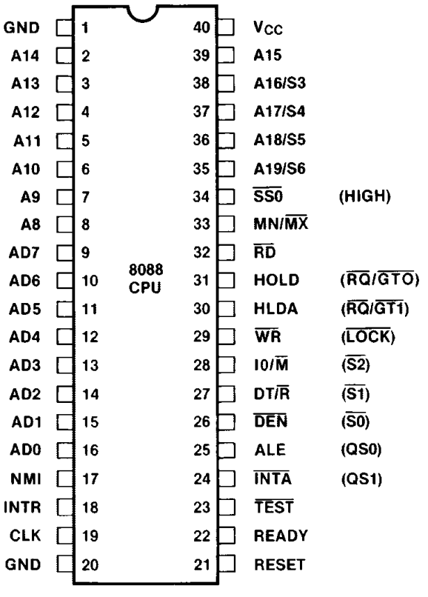
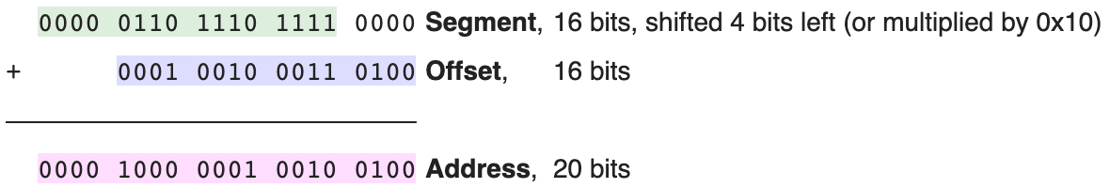
FAR Pointer in Real Mode
Early memory model. All memory accessible to all apps.
Primarily used in Intel 8088 (1979), 8086 (1978), 80186 (1982)
CPU Address width is 20 bits but register size is 16-bit
2^20 bytes = 1 MiB CPU accessible memory
https://en.wikipedia.org/wiki/X86_memory_segmentation

Slide 21
FAR Pointer in 286 Protected Mode
Introduced in 80286 (1982)
Privilege Levels: Rings 0 - 3
Larger memory access with 24-bit address width
16-bit segment mapped to 24-bit base address + offset
2^24 bytes = 16 MiB CPU accessible memory
Win 3.1 supports up to 256MB on ≥80386 but emulates 16MiB environment per app
All modern CPUs today still start of in Real Mode

Slide 22
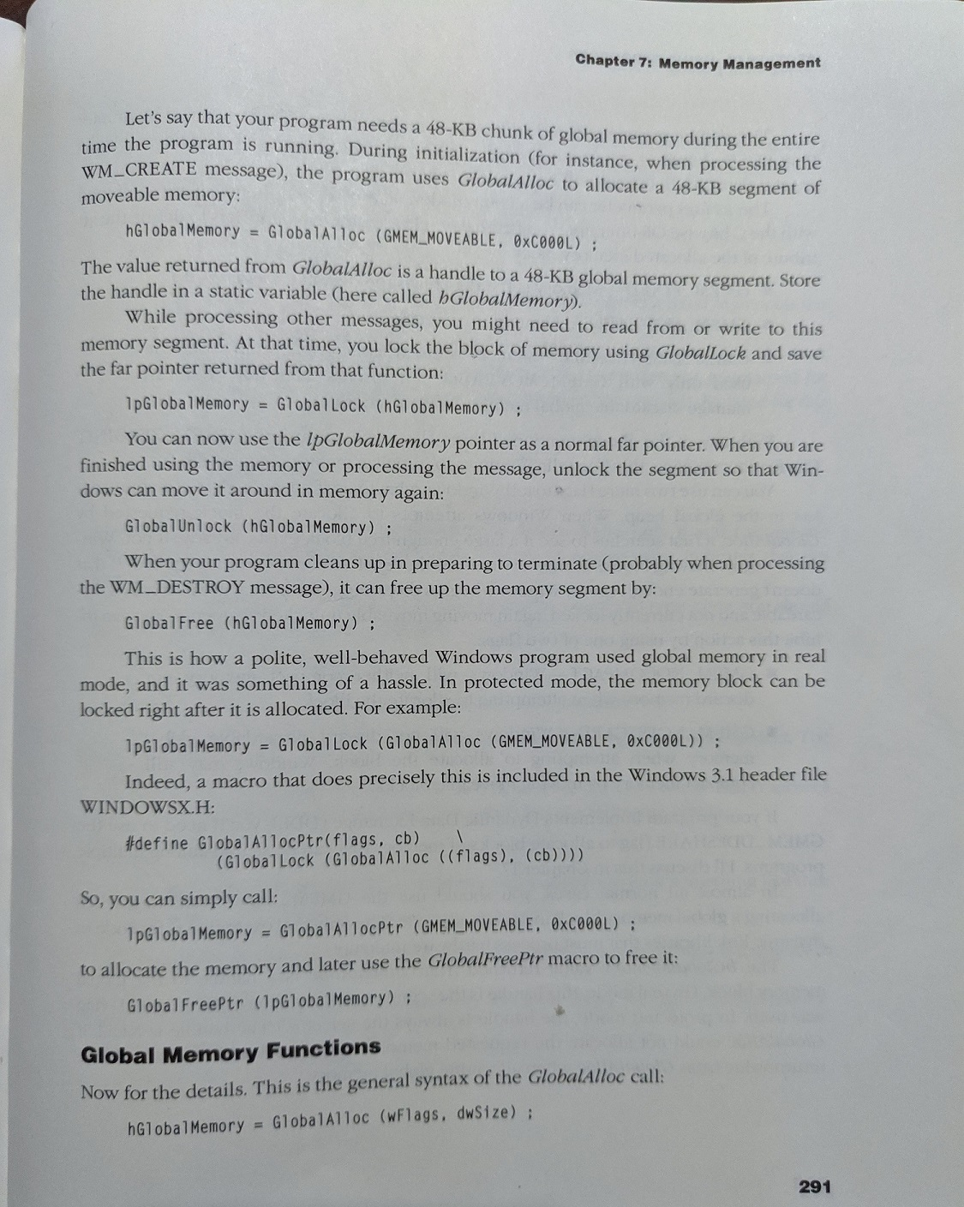
Allocating memory from Global Heap
#include <windowsx.h>
//Up to 64K is possible
#define MAX_GLOBAL_MEM_ALLOCATION 32000
LPSTR lpGlobalMemory;
DWORD allocatedMemorySize;
lpGlobalMemory = GlobalAllocPtr(GMEM_MOVEABLE, MAX_GLOBAL_MEM_ALLOCATION);
allocatedMemorySize = GlobalSize(GlobalPtrHandle(lpGlobalMemory));
printf("We got allocated %u bytes of memory\n", allocatedMemorySize);,
GlobalFreePtr(lpGlobalMemory);

Slide 23
Network

Slide 24
Making a POST request using Winsock APIs
#include <winsock.h>
#pragma comment(lib,"winsock.lib")
#define POST_MESSAGE_FORMAT "POST /api/chat.postMessage?channel=%s&as_user=true&text=%s HTTP/1.1\r\nHost: slack.com\r\nAuthorization: Bearer %s\r\nAccept: */*\r\nConnection: close\r\n\r\n"
WSADATA wsaData;
struct sockaddr_in serveraddr;
WORD wVersionRequested = MAKEWORD(1, 1);
nErrorStatus = WSAStartup(wVersionRequested, &wsaData);
sock = socket(PF_INET, SOCK_STREAM, IPPROTO_TCP);
memset(&serveraddr, 0, sizeof(serveraddr));
serveraddr.sin_family = AF_INET;
serveraddr.sin_addr.s_addr = inet_addr(ipaddress);
serveraddr.sin_port = htons((unsigned short) port);
error = connect(socketID, (struct sockaddr *) &serveraddr, sizeof(serveraddr));
sprintf(buff, POST_MESSAGE_FORMAT, "win31", "hello", "token");
bytesSent = send(socketID, request, requestLength, 0);
bytesReceivedThisInstant = recv(socketID, (char *) &buff, 1, 0);
closesocket(socketID);
WSACleanup();

Slide 25
No HTTPS APIs in Win 3.1

Slide 26

Cheat with http-to-https proxy
HTTP
HTTPS
HTTP to HTTPS proxy
HTTPS proxy written in Golang running on another modern system
Receives HTTP request from Slack client
Relays to Slack as a HTTPS connection
Relays result back to Slack client
I’m not porting highly complex OpenSSL or any SSL libraries to an unsupported 16-bit Windows platform
“Purists may not like this solution but this is the best I can do with my abilities in a reasonable amount of time.”

Slide 27
Modern JSON parsing (eg Golang)
X
recvJson := “ {"ok":true,"channel":"CPV9L2VT3","ts":"1576075350.002900","message":{"bot_id":"BPVA8FQUR","type":"message","text":"hello","user":"UQ2NT009J","ts":"1576075350.002900","team":"TQ5D6U4KY","bot_profile":{"id":"BPVA8FQUR","deleted":false,"name":"Slack API Tester”…”
var result map[string]interface{}
json.Unmarshal([]byte(recvJson), &result)
jsnMap := result[“message"].(map[string]interface{})
for key, value := range jsnMap {
fmt.Println(key, value.(string))
}
Adapted from:
https://www.sohamkamani.com/blog/2017/10/18/parsing-json-in-golang/

Slide 28
JSON Parsing
#include "jsmn.h"
#define MAX_TOKENS 128
jsonString := “ {"ok":true,"channel":"CPV9L2VT3","ts":"1576075350.002900","message":{"bot_id":"BPVA8FQUR","type":"message","text":"hello","user":"UQ2NT009J","ts":"1576075350.002900","team":"TQ5D6U4KY","bot_profile":{"id":"BPVA8FQUR","deleted":false,"name":"Slack API Tester”…”
jsmn_parser parser;
jsmntok_t currentToken;
jsmntok_t tokens[MAX_TOKENS];
jsmn_init(&parser);
jsmn_parse(&parser, jsonString, lengthOfJson, tokens, MAX_TOKENS);
for(index = 0; index < MAX_TOKENS; index++){
currentToken = tokens[index];
tokenStartPosition = currentToken.start;
tokenSize = currentToken.end - tokenStartPosition;
if((tokenSize <= 0) || (tokenSize > MAX_TOKEN_KEYWORD_SIZE)){
continue;
}
memset(currentTokenString, 0, MAX_TOKEN_KEYWORD_SIZE);
_fmemcpy(currentTokenString, startOfJson + tokenStartPosition, tokenSize);
printf("Current token %s\n", currentTokenString);
}
Using C89-compatible JSMN library
https://github.com/zserge/jsmn
JSMN does not output a map to save memory
Outputs fixed array of token structs that points to token boundaries in the original JSON
typedef struct {
jsmntype_t type; // Token type
int start; // Token start position
int end; // Token end position
int size; // Number of child (nested) tokens
} jsmntok_t;

Slide 29
Parsing Json in portions
{"ok":true,"messages":
[{type":"message","text":"hello YY","user":"UQ2NT009J", ts":":uuuu","team":"id":…}
{type":"message","text":“Hi KM","user":“YYYYYYYYYY", ts":":uuuu","team":"id":…}
{type":"message","text":“how are you","user":"UQ2NT009J”, ts":":uuuu","team":"id":…}
{type":"message","text":“I’m fine","user":“YYYYYYYYYY", ts":":uuuu","team":"id":…}
…]
}
GET https://slack.com/api/conversations.history

Slide 30
Parsing Json in portions
{"ok":true,"messages":
[{type":"message","text":"hello YY","user":"UQ2NT009J", ts":":uuuu","team":"id":…}
{type":"message","text":“Hi KM","user":“YYYYYYYYYY", ts":":uuuu","team":"id":…}
{type":"message","text":“how are you","user":"UQ2NT009J”, ts":":uuuu","team":"id":…}
{type":"message","text":“I’m fine","user":“YYYYYYYYYY", ts":":uuuu","team":"id":…}
…]
}
GET https://slack.com/api/conversations.history
Use C function strstr to look for “text”

Slide 31
Parsing Json in portions
{"ok":true,"messages":
[{type":"message","text":"hello YY","user":"UQ2NT009J", ts":":uuuu","team":"id":…}
{type":"message","text":“Hi KM","user":“YYYYYYYYYY", ts":":uuuu","team":"id":…}
{type":"message","text":“how are you","user":"UQ2NT009J”, ts":":uuuu","team":"id":…}
{type":"message","text":“I’m fine","user":“YYYYYYYYYY", ts":":uuuu","team":"id":…}
…]
}
GET https://slack.com/api/conversations.history
Use C function strstr to look for “text”
Ask JSMN to process 4 tokens then verify 2 tokens later is “user”

Slide 32
Parsing Json in portions
{"ok":true,"messages":
[{type":"message","text":"hello YY","user":"UQ2NT009J", ts":":uuuu","team":"id":…}
{type":"message","text":“Hi KM","user":“YYYYYYYYYY", ts":":uuuu","team":"id":…}
{type":"message","text":“how are you","user":"UQ2NT009J”, ts":":uuuu","team":"id":…}
{type":"message","text":“I’m fine","user":“YYYYYYYYYY", ts":":uuuu","team":"id":…}
…]
}
GET https://slack.com/api/conversations.history
Use C function strstr to look for “text”
Ask JSMN to process 4 tokens then verify 2 tokens later is “user”
Extract message text and user ID

Slide 33
Parsing Json in portions
{"ok":true,"messages":
[{type":"message","text":"hello YY","user":"UQ2NT009J", ts":":uuuu","team":"id":…}
{type":"message","text":“Hi KM","user":“YYYYYYYYYY", ts":":uuuu","team":"id":…}
{type":"message","text":“how are you","user":"UQ2NT009J”, ts":":uuuu","team":"id":…}
{type":"message","text":“I’m fine","user":“YYYYYYYYYY", ts":":uuuu","team":"id":…}
…]
}
GET https://slack.com/api/conversations.history
Use C function strstr to look for “text”
Ask JSMN to process 4 tokens then verify 2 tokens later is “user”
Extract message text and user ID
Repeat Step 1 by starting end Step 3

Slide 34
Test Driven Development (TDD)
No C89 test framework for Visual C++ 1.52
Custom test framework

Slide 35
Jsnparse
jsnparse.h
jsnparse.c
test.h
test_jsnparse_parseChannelList()
test_jsnparse_parseMessageList()
test_jsnparse_parseUserList()
test_jsnparse()
Network
network.h
network.c
test.h
test_data_send_recv()
test_large_data_send_recv()
test_network()
Test.mak
TestMain.c
replay.go
Loops back whatever was received on the TCP Connection
RestAPI
restapi.h
restapi.c
test.h
test_restapi_sendMessageToChannel()
test_restapi_getChannelMessages()
test_restapi_getChannelList()
test_restapi_getUsersList()
test_restapi()
mockprox.go
Pretends to be Slack server
GET /api/conversations.list
ouconlis.txt
GET /api/conversations.history
ouconhis.txt
GET /api/users.list
ouusrlis.txt
POST /api/chat.postMessage
ouposmsg.txt

Slide 36
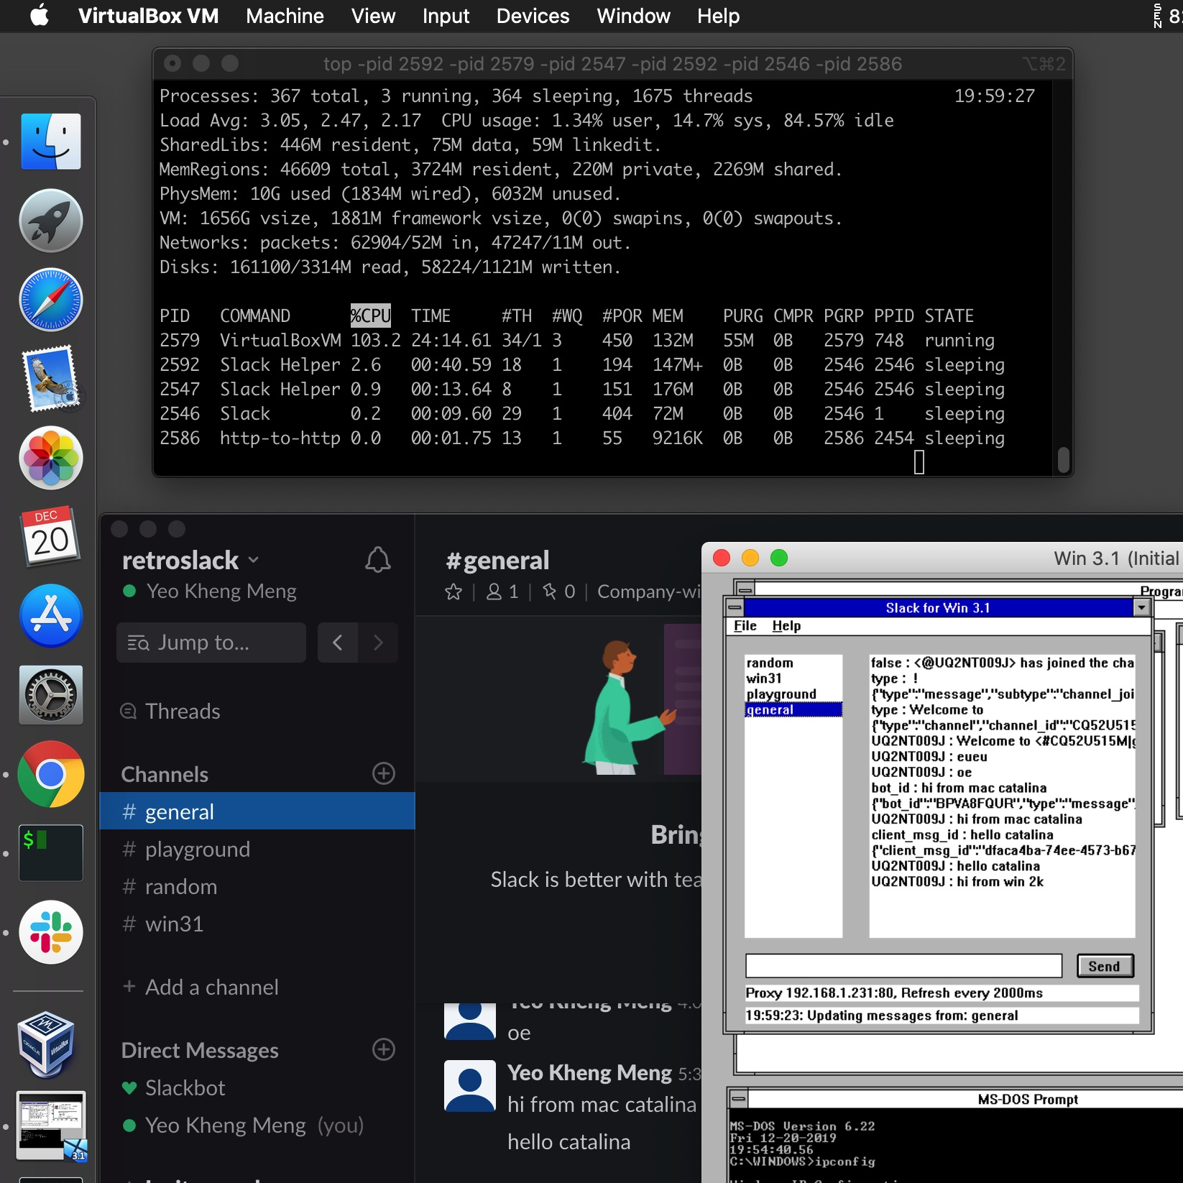
RAM Usage comparison
Official Mac Slack app
Slack Helper Renderer: 147.4MiB
Slack Helper GPU: 176.5MiB
Slack: 72.2MiB
Total: 396.1 MiB
VM setup
Virtualbox (DOS 6.22, WFW 3.11, App): 132 MiB
HTTPS proxy: 9 MiB
Total: 141 MiB

Slide 37
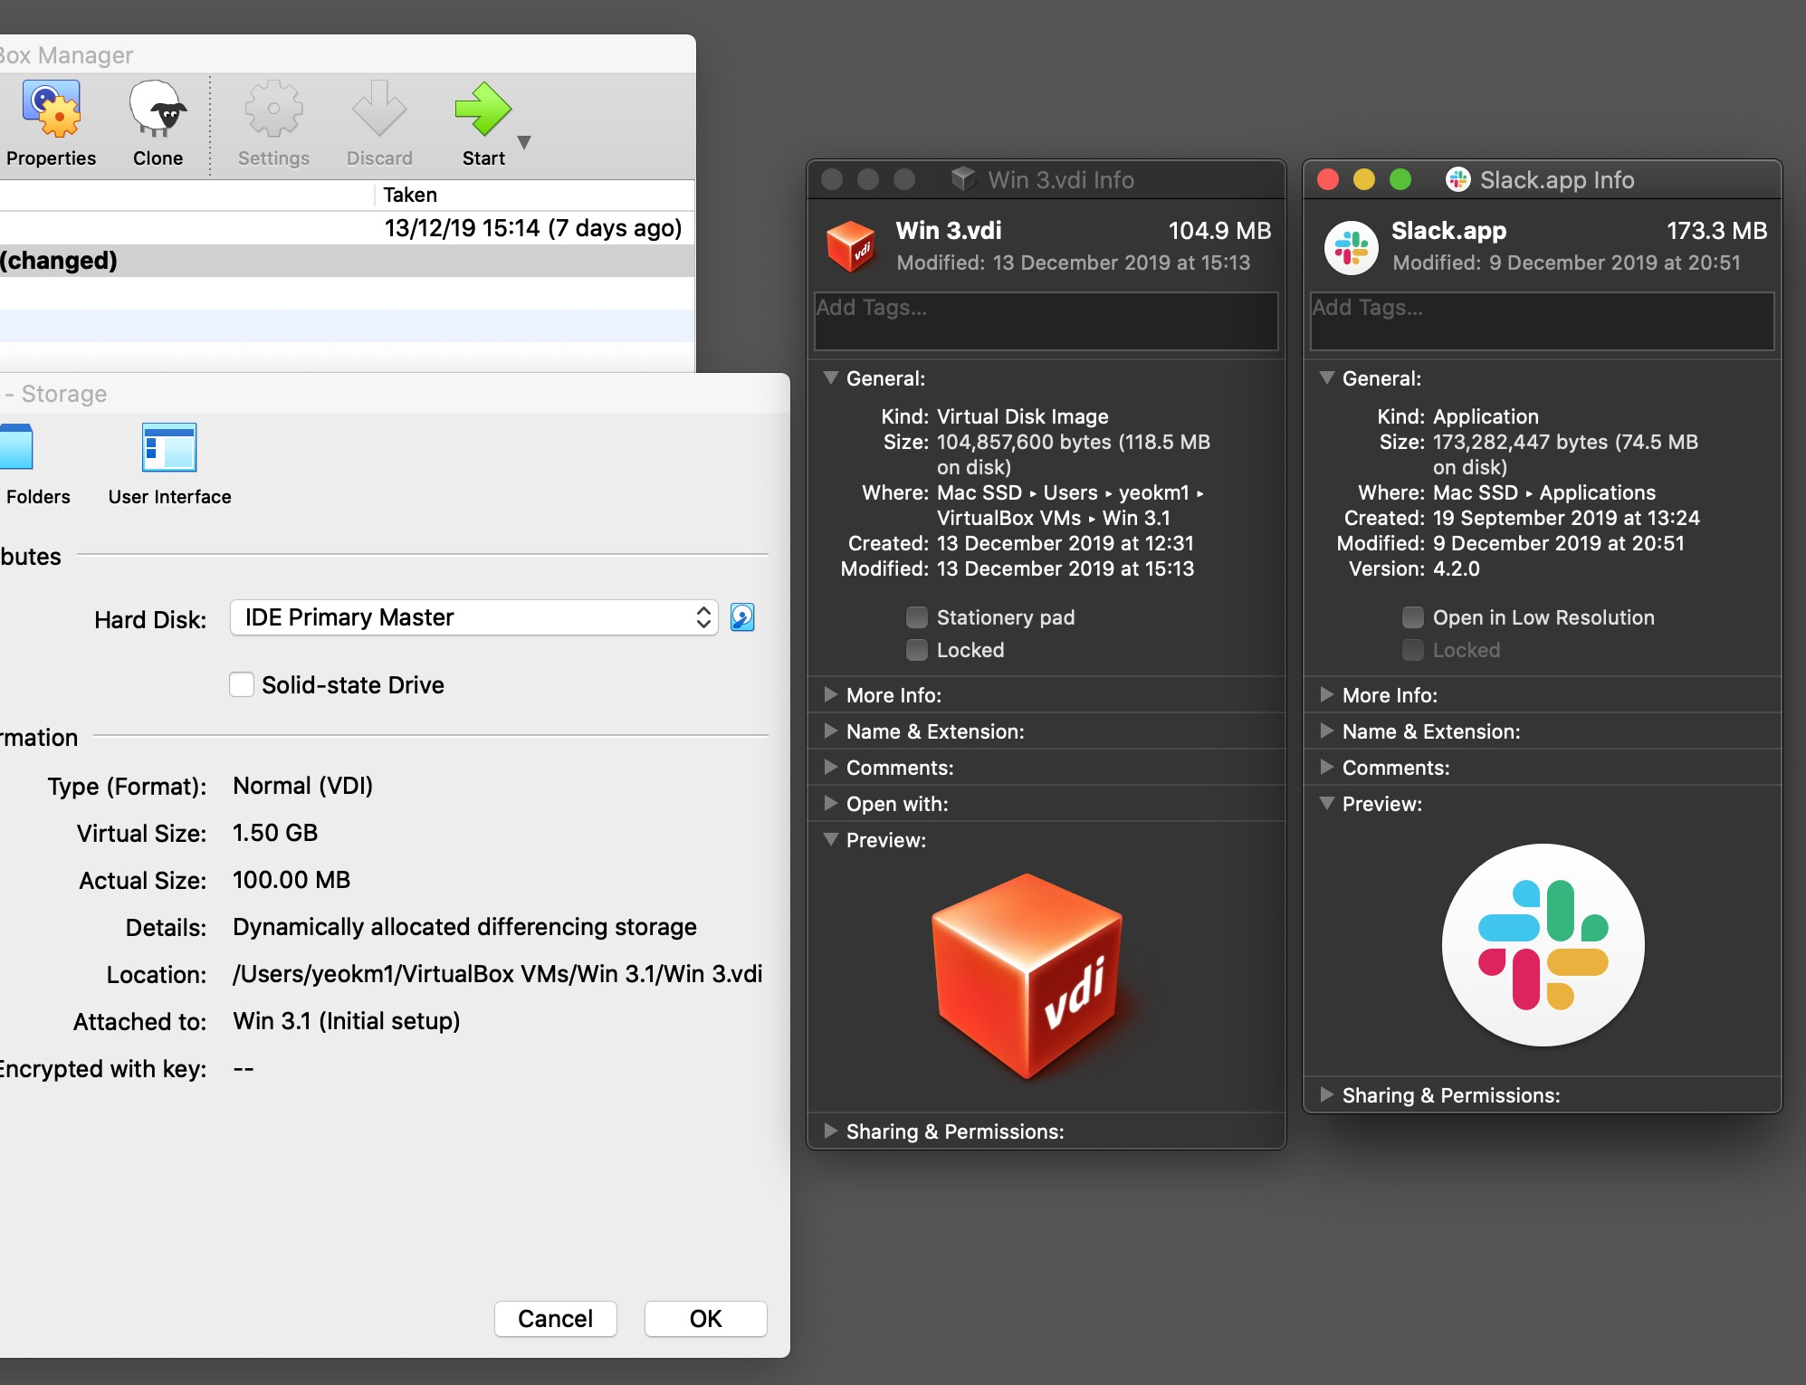
Disk usage comparison
Slack App: 173.3 MB
VM disk: 104.9 MB

Slide 38
Takeaways
Writing code for resource-constrained systems
Learn how things happen under the hood
Reading books forces one to go through the material in more detail
Understand the plight of yesteryear programmers

